Slide 1
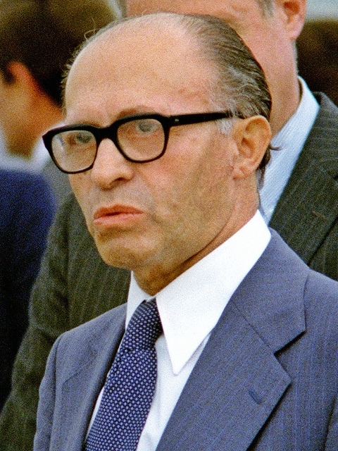

Menachem Begin
By: Colin Quinn

Slide 2
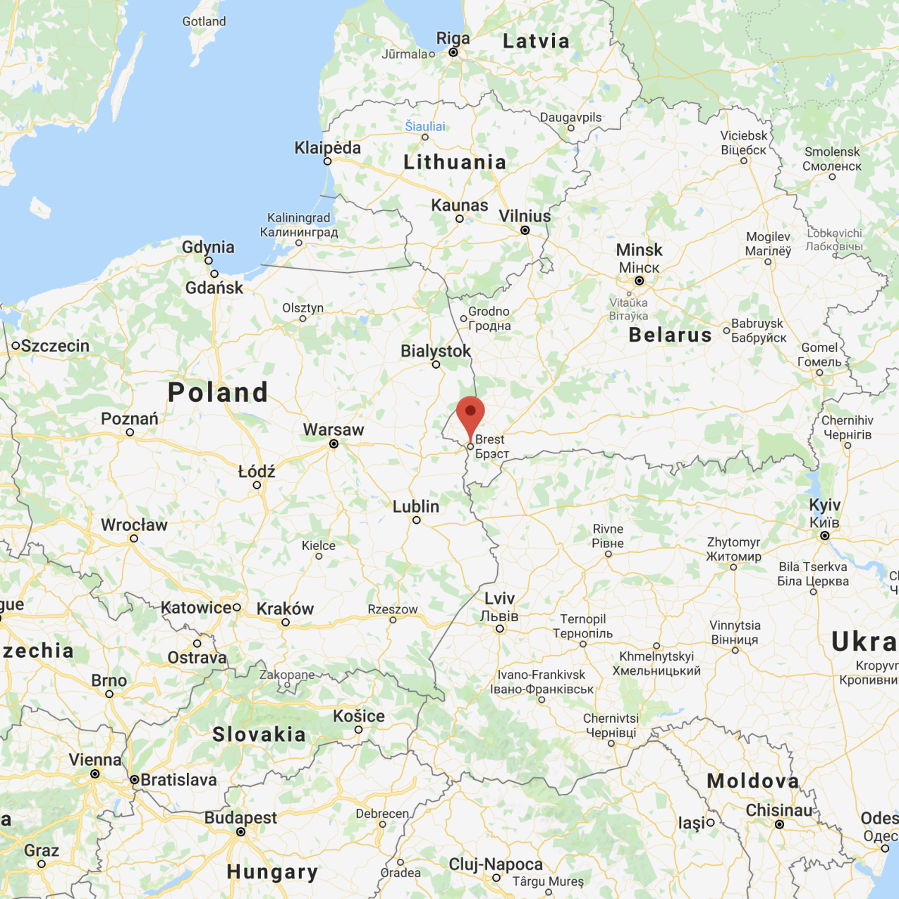
The Start of Menachem Begin
From Brest-Litovsk, or current day Brest, Belarus
Born on August 16, 1913
Died March 9, 1992
Mother’s side of family was high ranking Rabbis
Father was a timber merchant, leader of the social community, and Zionist

Slide 3
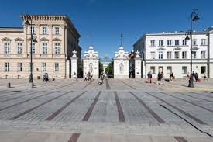
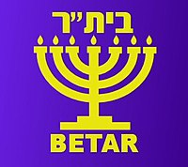
Begin’s Early Life:
A member of the Hashomer Hatzair Zionist movement until 13 years old.
At 16 he joined the Betar.
Begin later studied law at the University of Warsaw.
Graduated in 1935, but instead of practicing law, became a disciple of the founder of Betar, Vladimir “Ze’ev” Jabotinsky.

Slide 4
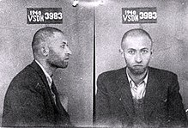
The Entry into Politics
In 1937, Begin acted as the head of the Betar in Czechoslovakia and Poland
Attempted to smuggle 1,500 Jews into Romania in August of 1939, just before the Soviets invaded
September 1937, he and many other Jewish leaders escape to Wilno
Begin was later imprisoned for being a Zionist on September 20, 1940
In 1941, Begin joined the Free Polish Anders’ Army as Corporal Officer
Begin lost his father, mother, and older brother in the holocaust

Slide 5
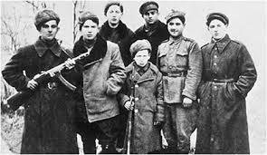
His Rise to Popularity Amongst Zionists
Believed that the Zionists were too cooperative with the British, and that the only way to save themselves was to expel the British and form a Jewish state
Begin led an armed rebellion against the British in response to the White Paper of 1939
During the Jewish Resistance Movement of 1945, Begin formed an attack on the British military headquarters in Jerusalem

Slide 6

The Begin(ning) of His Political Career
Begin formed the politically right-wing Herut (Freedom) party
While campaigning in 1948, the Herut party was deemed “closely akin in its organization, methods, political philosophy, and social appeal to the Nazi and Fascist parties” by the likes of Albert Einstein, Sidney Hook, and other Rabbis.
Begin was banned from the U.K. after being noted as the “leader of the notorious terrorist organisation Irgun”.
In 1952, Begin led a riot over the Reparations Agreement between Israel and West Germany

Slide 7

Political Career Continued....
Despite being condemned in mainstream media, Begin’s passion appealed to many
Begin announced that he would resign from the Herut party, but reversed that upon the crowd pleading him to stay
In 1977, Likud and Begin won the Knesset election, ending 30 years of Mapai rule, becoming the Prime Minister of Israel

Slide 8

Social Reformations
Tuition for secondary education was eliminated
Long-term healthcare and a national income support system implemented
Project Renewal, still continues in high risk areas today
Pushed a more “free market” rather than a socialist economy

Slide 9


Questions?

